Slide 1
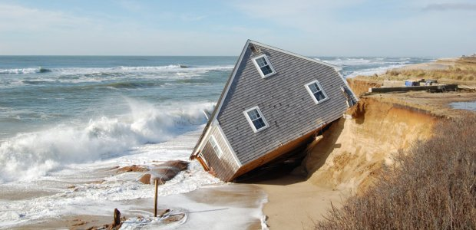

Slide 2
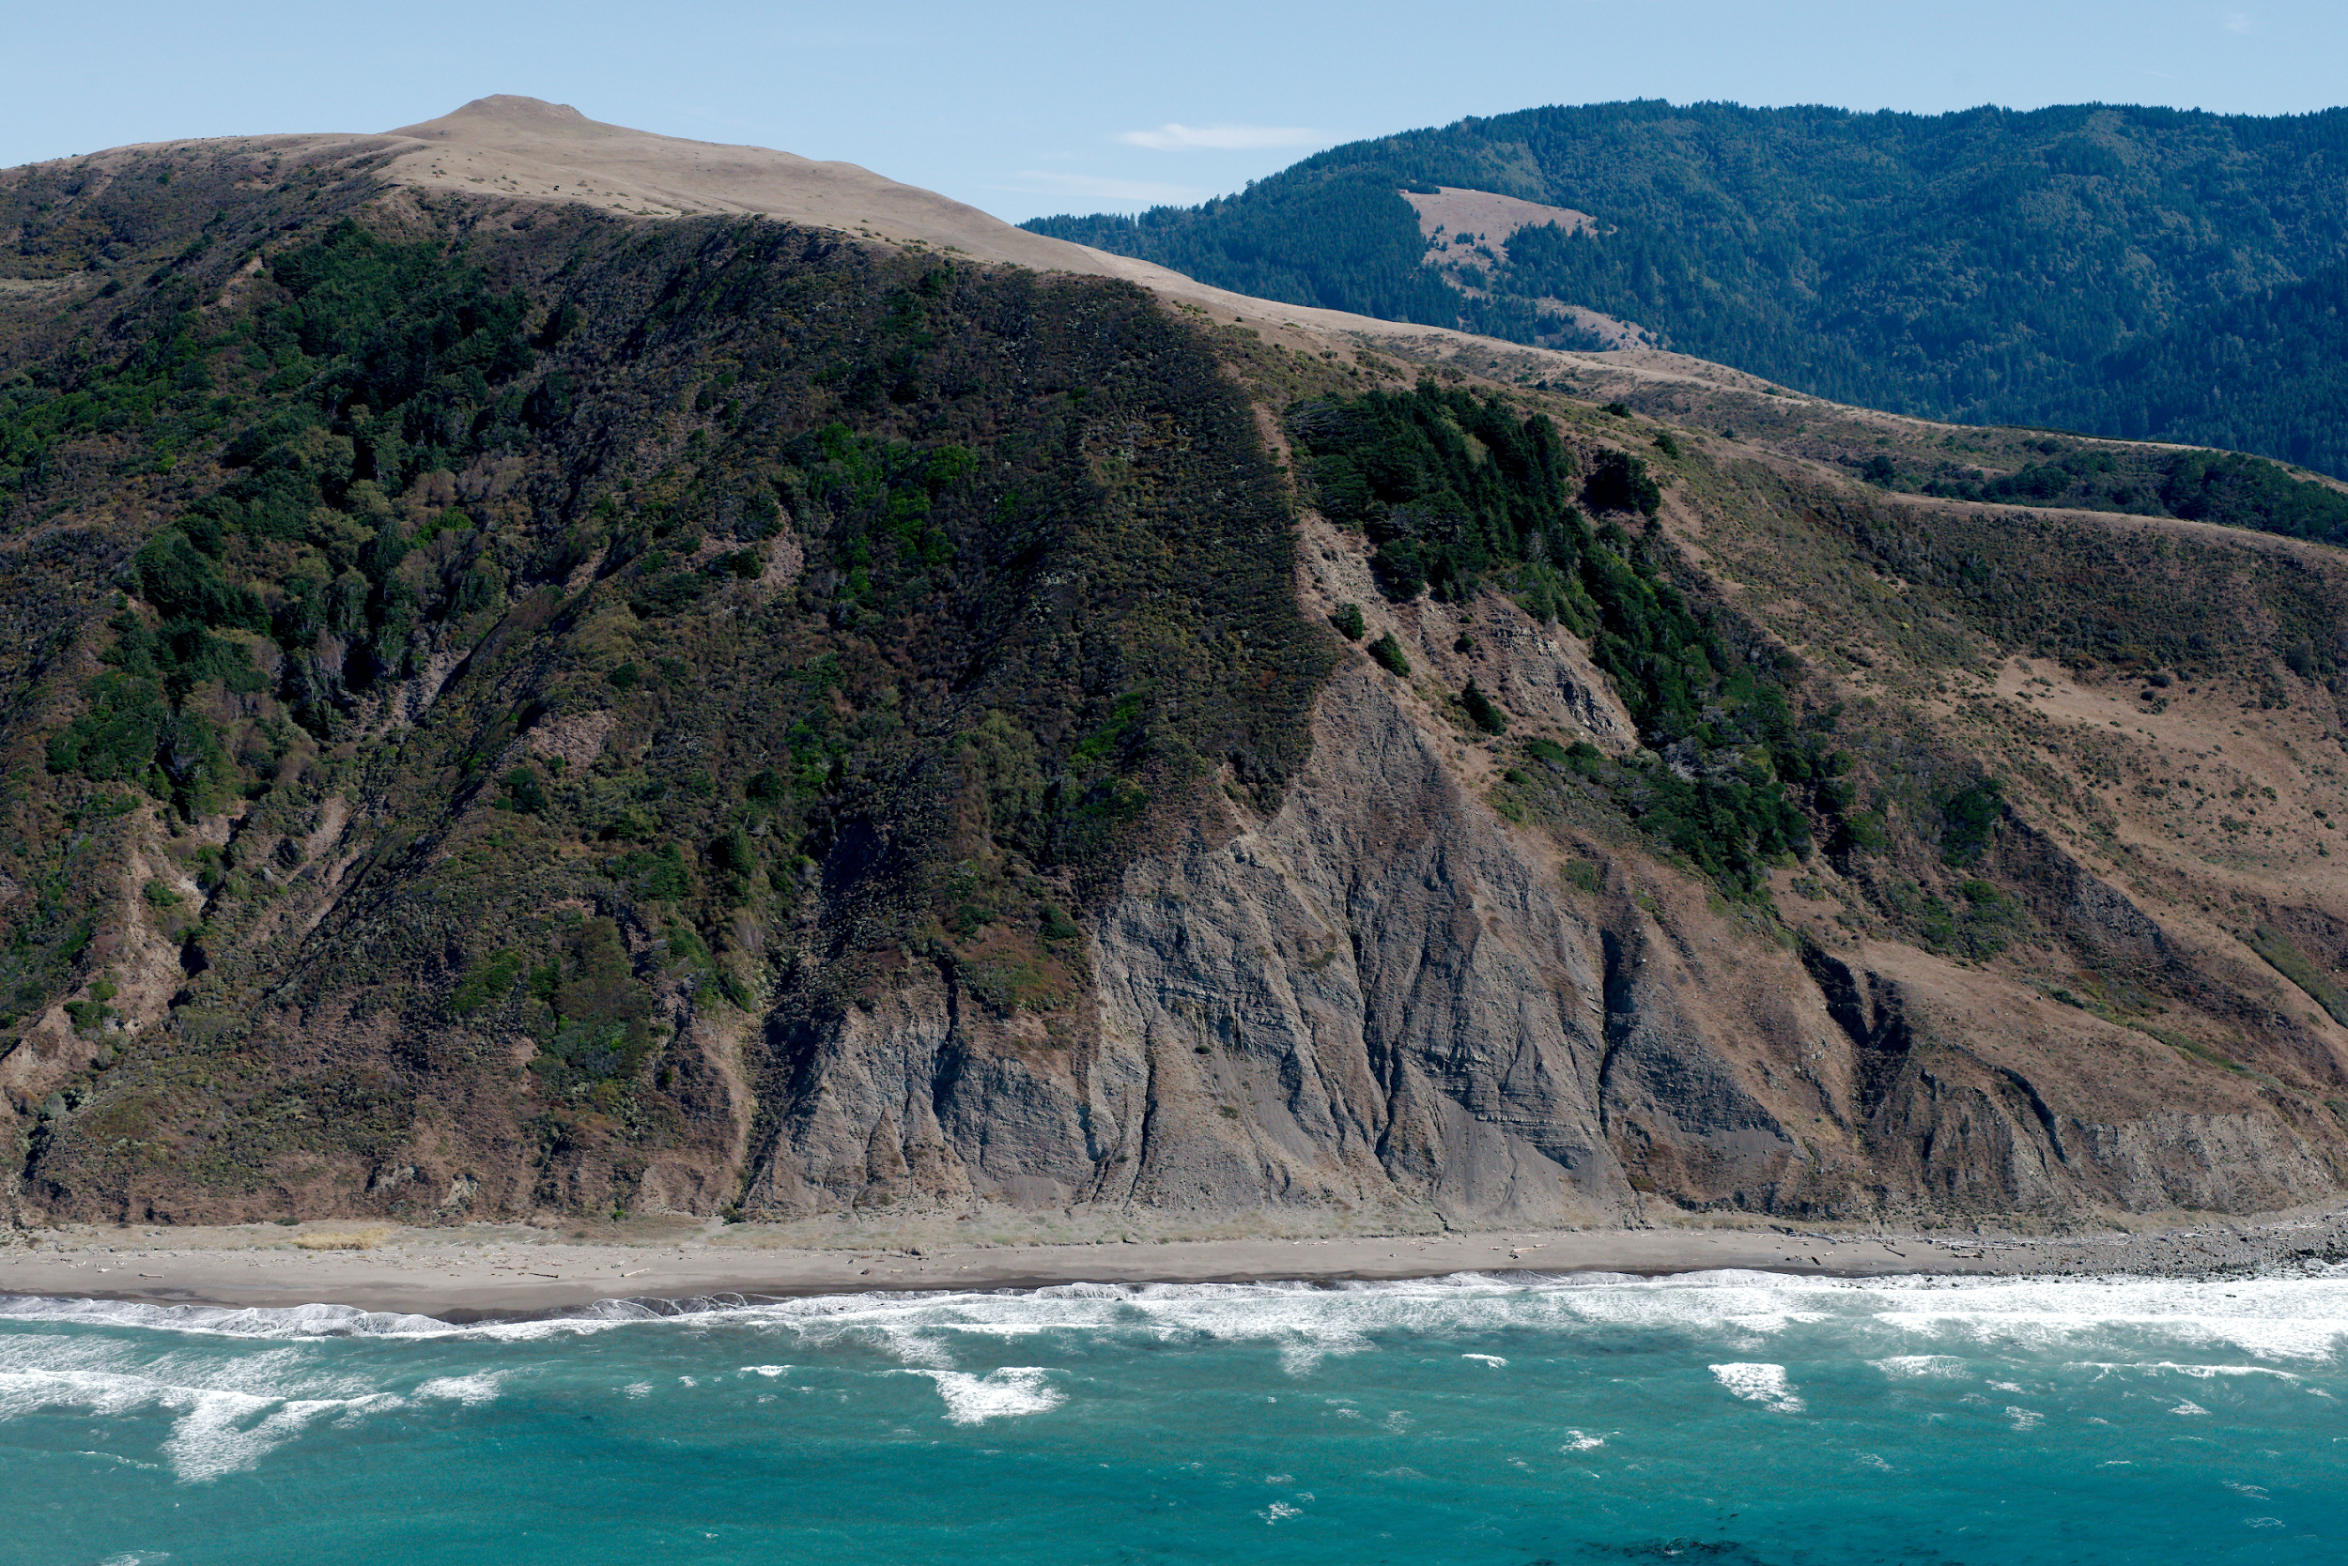



Quantifying coastal erosion along the Lost Coast, California
By:
Trae Doty
Mentor:
Dr. Mike Smith

Slide 3
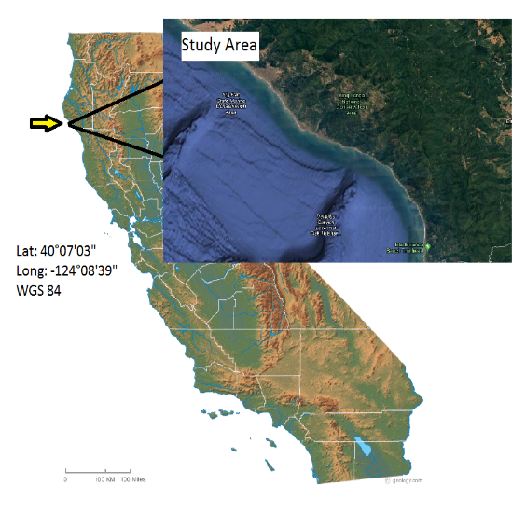

Slide 4
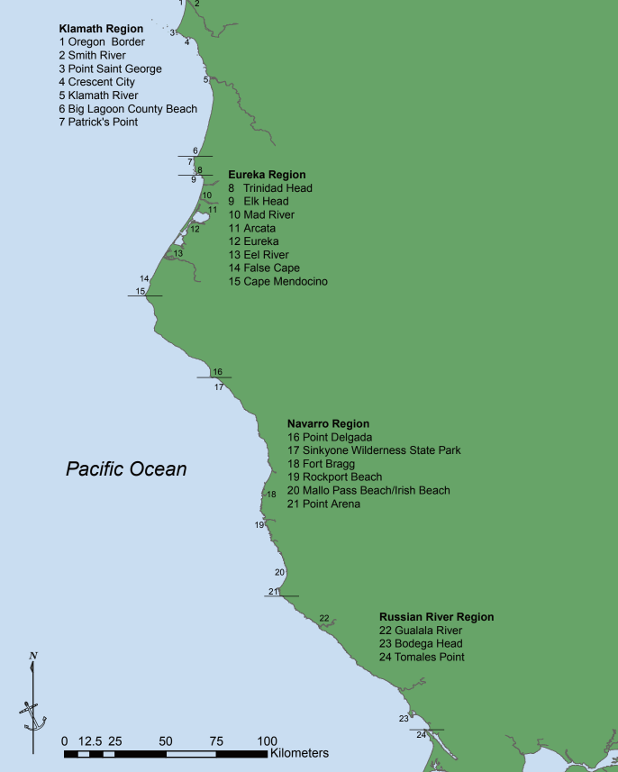
Modified from Hapke and Reid, 2007
Notes:
Discuss overlap, applications, best case scenarios for photography

Slide 5
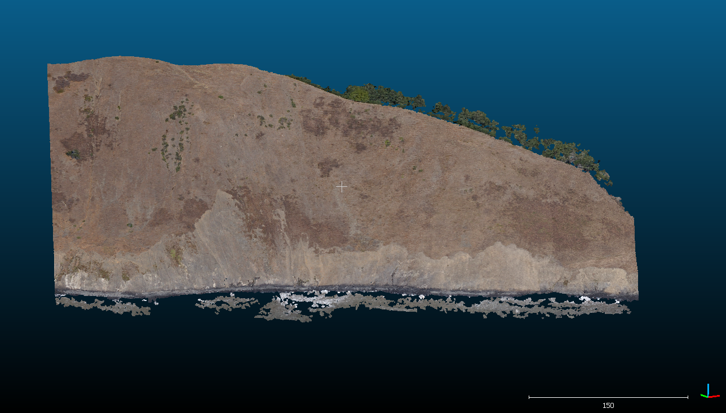
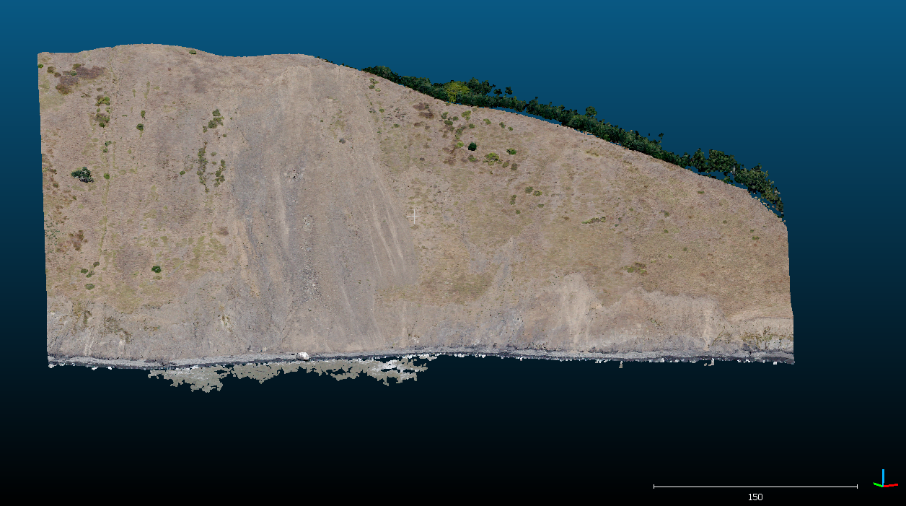
2005 model:
2013 model:

Slide 6
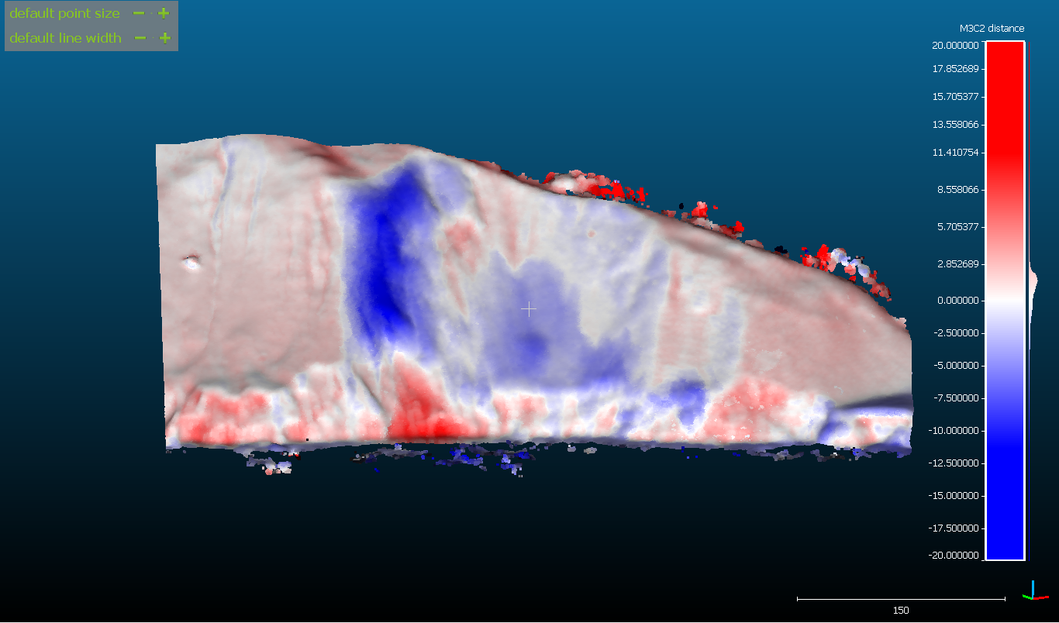
2005-2013 difference map:

Slide 7
Thanks to:
Arizona Space Grant Consortium
California Coastal Records Project
Dr Daniel Buscomb NAU
Dr Mike Smith NAU

Slide 8
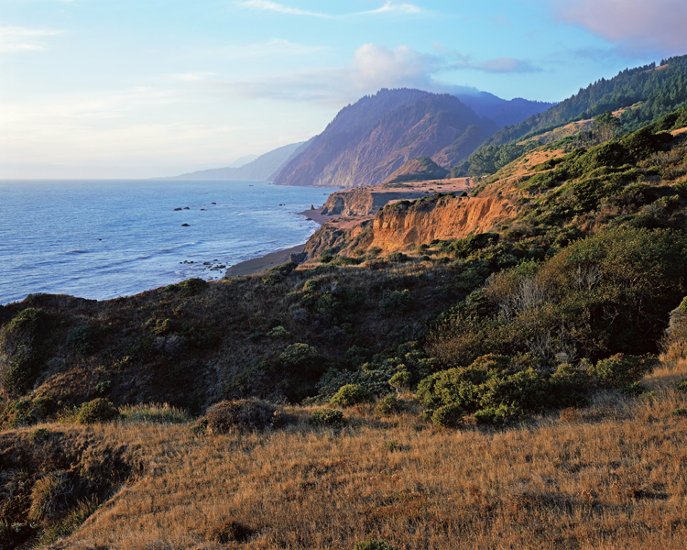
Questions?

